Slide 1
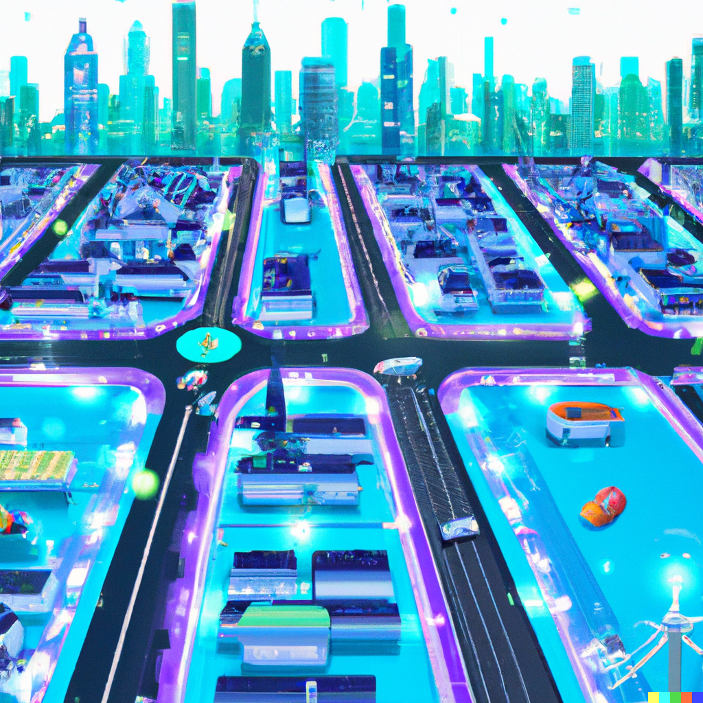
Smart Street Lighting System
Smart City
Furkan Ali Yurdakul – 7215046
Bruno Hyska – 7216772
Ian Murnane – 7216662
Elbek Bakiev – 7216249

Slide 2
Content
Smart City
Smart City Lighting
Diagrams
Concept Solutions
Task Scheduling
Testing
Notes:
Talk about what the presentation exists of and what the people can expect to see
First we talk about Smart Cities -> Smart Street Lighting -> Demonstration of the concept

Slide 3
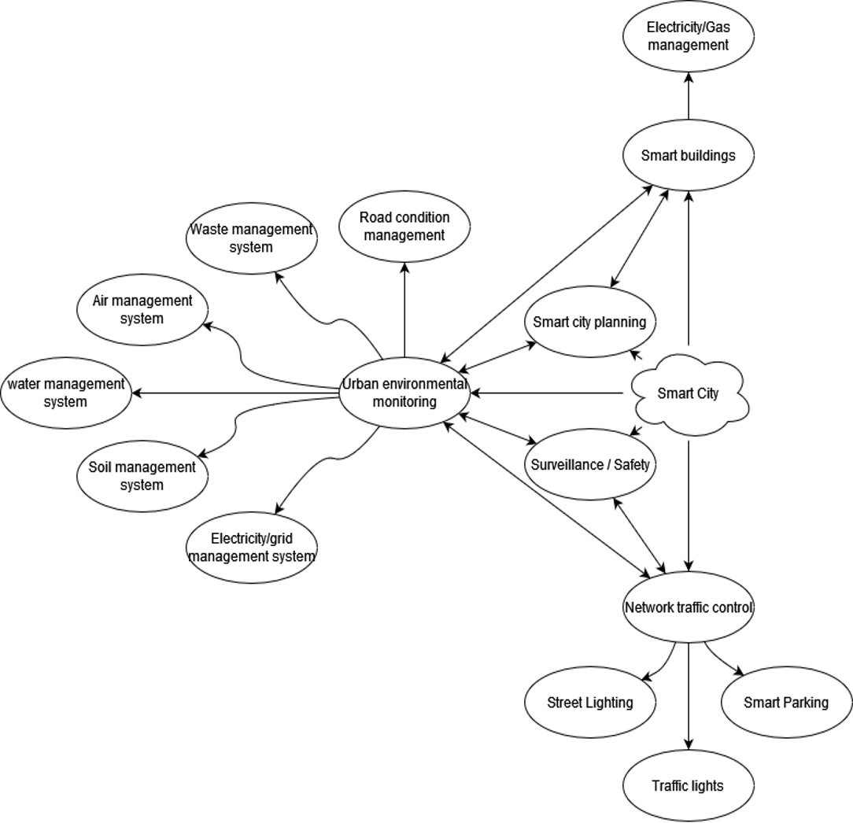
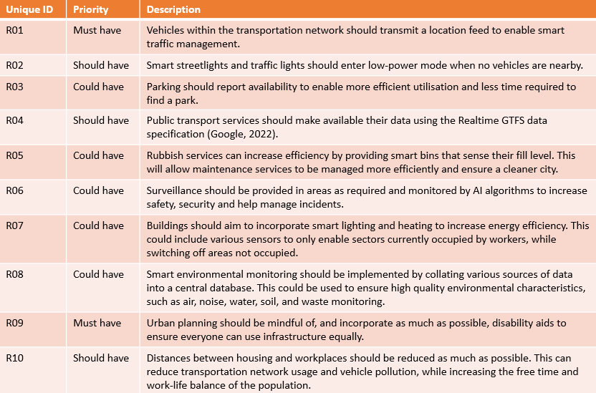
Smart City
Mind map
Notes:
To be able to dive in deeper we first created the bigger image about a Smart city and all the connected blocks within it.
Explain about how some parts are interconnected. For example; that road condition management goes hand in hand with network traffic control.

Slide 4
Smart City
Unique ID | Priority | Description
R01 | Must have | Vehicles within the transportation network should transmit a location feed to enable smart traffic management.
R02 | Should have | Smart streetlights and traffic lights should enter low-power mode when no vehicles are nearby.
R03 | Could have | Parking should report availability to enable more efficient utilisation and less time required to find a park.
R04 | Should have | Public transport services should make available their data using the Realtime GTFS data specification ​(Google, 2022)​.
R05 | Could have | Rubbish services can increase efficiency by providing smart bins that sense their fill level. This will allow maintenance services to be managed more efficiently and ensure a cleaner city.
R06 | Could have | Surveillance should be provided in areas as required and monitored by AI algorithms to increase safety, security and help manage incidents.
R07 | Could have | Buildings should aim to incorporate smart lighting and heating to increase energy efficiency. This could include various sensors to only enable sectors currently occupied by workers, while switching off areas not occupied.
R08 | Could have | Smart environmental monitoring should be implemented by collating various sources of data into a central database. This could be used to ensure high quality environmental characteristics, such as air, noise, water, soil, and waste monitoring.
R09 | Must have | Urban planning should be mindful of, and incorporate as much as possible, disability aids to ensure everyone can use infrastructure equally.
R10 | Should have | Distances between housing and workplaces should be reduced as much as possible. This can reduce transportation network usage and vehicle pollution, while increasing the free time and work-life balance of the population.
Requirements
Notes:
To be able to dive in deeper we first created the bigger image about a Smart city and all the connected blocks within it.
Explain about how some parts are interconnected. For example; that road condition management goes hand in hand with network traffic control.

Slide 5
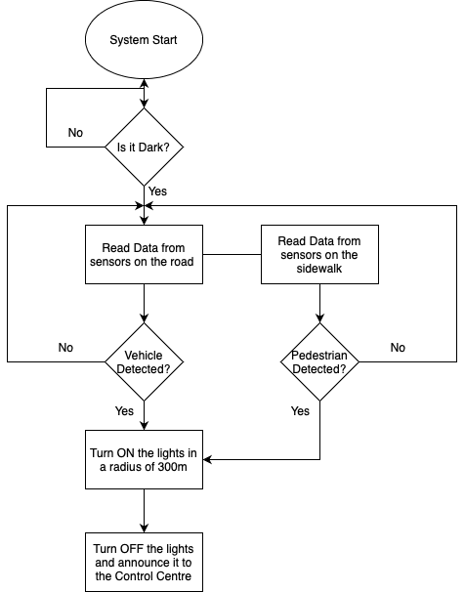
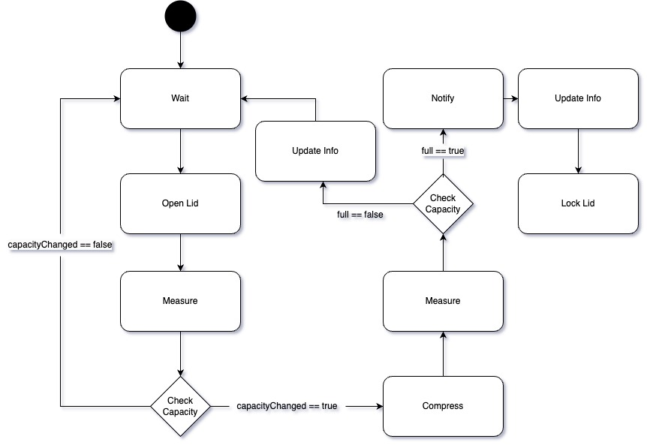
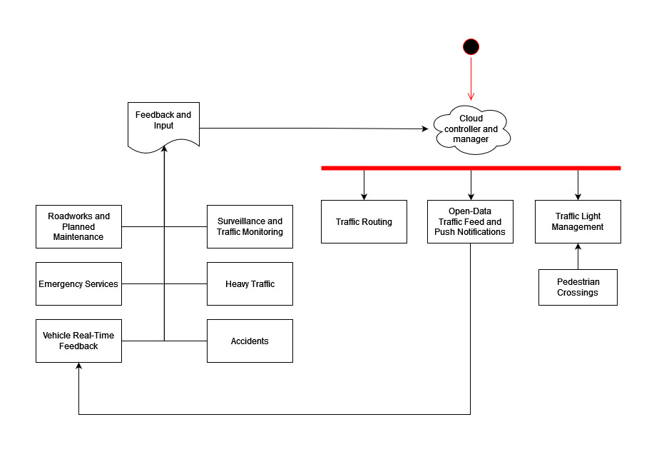
Smart City
Activity diagrams
Smart Street Lightning
Smart Waste Management
Smart traffic control
Notes:
Created 3 Activity diagrams to understand the concept of Smart cities
First to fade in is Smart traffic control
Talk about the construction of the diagram
Press next to fade into Smart waste management
Talk about the construction of the diagram
Press next to fade into Smart street lighting
Talk about the construction of the diagram
And talk about why we chose Smart street lighting instead of the others to dive deeper into

Slide 6
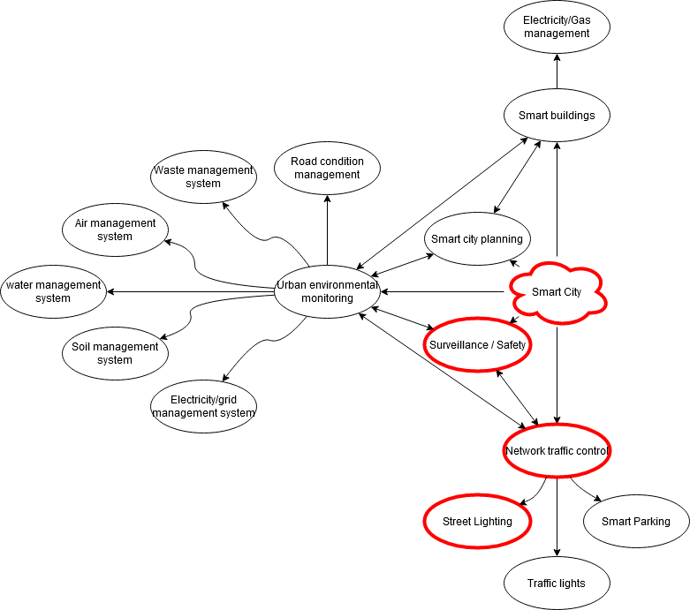
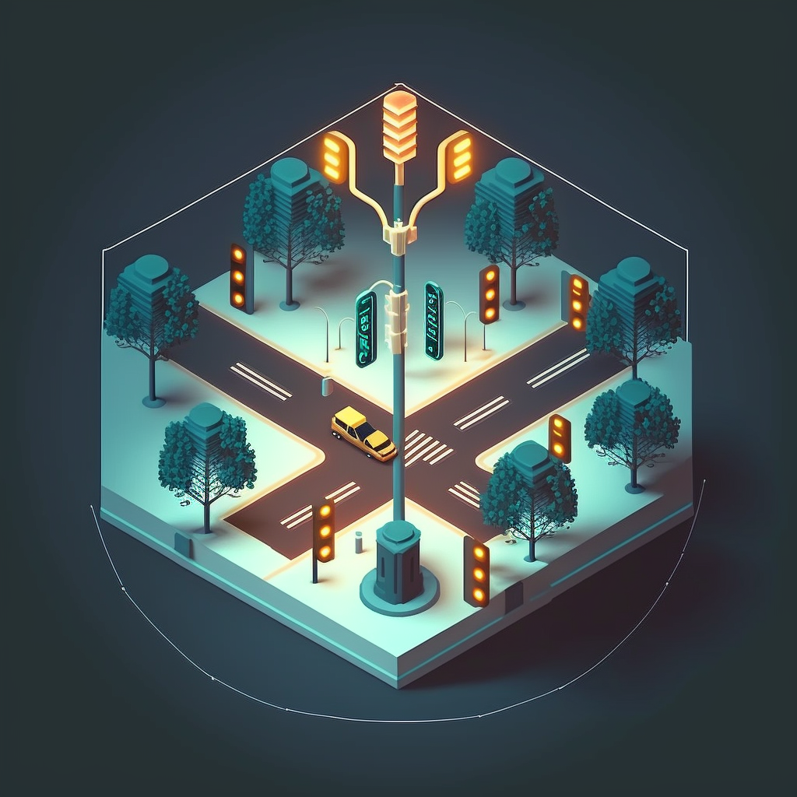
Smart Street Lighting
Notes:
Talk about how the 3 blocks make 1 system which ends up being the Smart street lighting system.

Slide 7

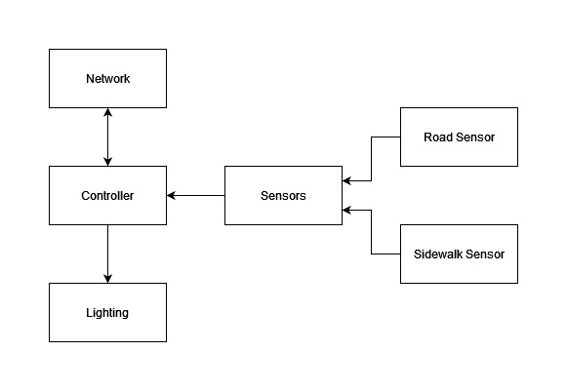


Smart Street Lighting
Context Diagram
Notes:
Talk about the general idea what kind of hardware is expected to be active in order to create a smart street lighting.

Slide 8
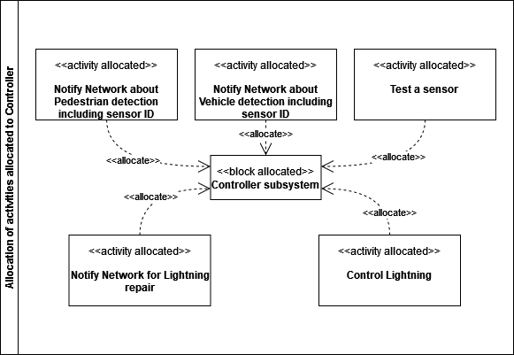
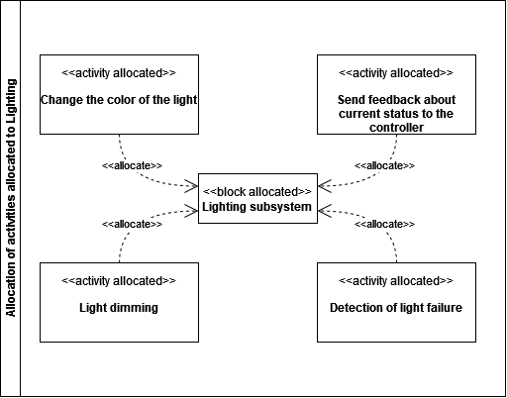
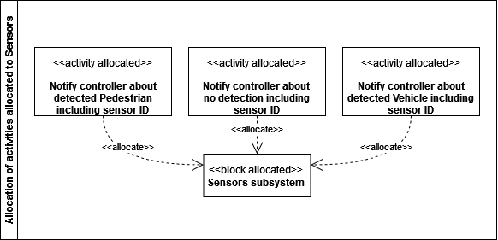
Smart Street Lighting
Allocation diagrams
Notes:
These are all the expected activities allocated to certain hardware from the context diagram
Go from left to right

Slide 9
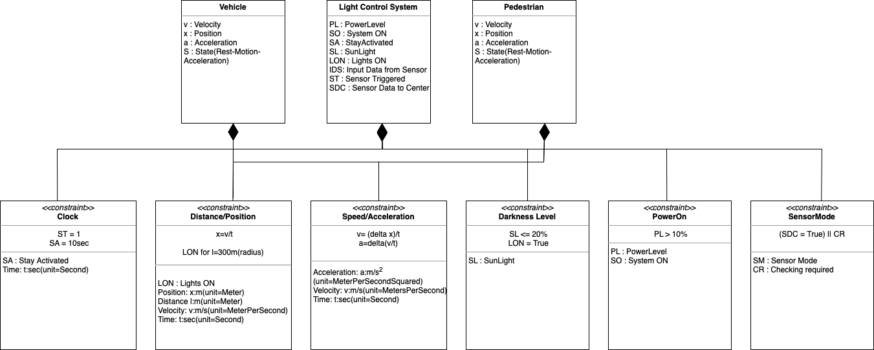
Smart Street Lighting
Constraint Diagram

Slide 10
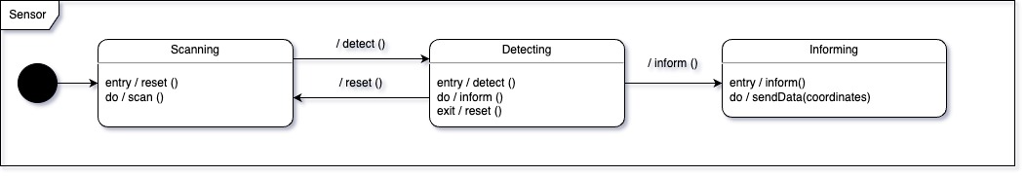
State Machine
Sensor
Scanning – the sensor is most of the time in waiting (scanning state).
Detecting – detects a specific type of input (motion of an object) and converts it into an electrical signal.
Informing – sends data to a Cloud.

Slide 11
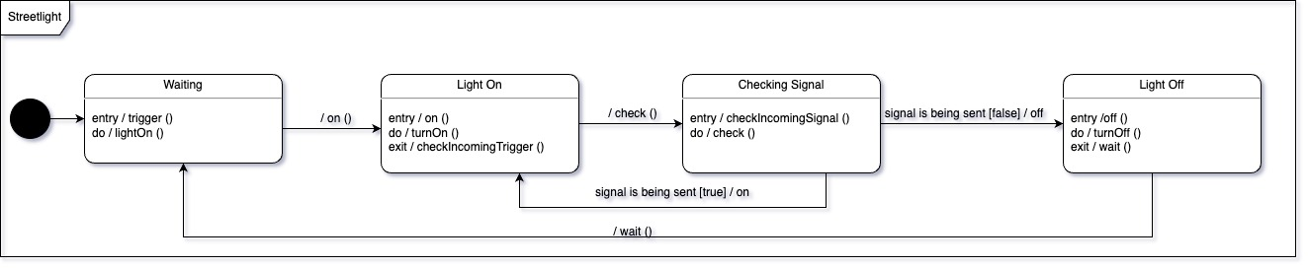
State Machine
Streetlight
Waiting – waiting trigger from Cloud.
Light On – turn on the light when triggered from Cloud.
Checking Signal – check if still being triggered by Cloud. If yes, a previous state remains active, otherwise light is turned off.

Slide 12
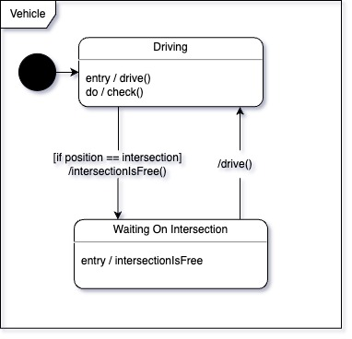
State Machine
Vehicle
Driving – the car is driven on the road
Waiting On Intersection – car waits for the signal from Cloud that the intersection is free

Slide 13
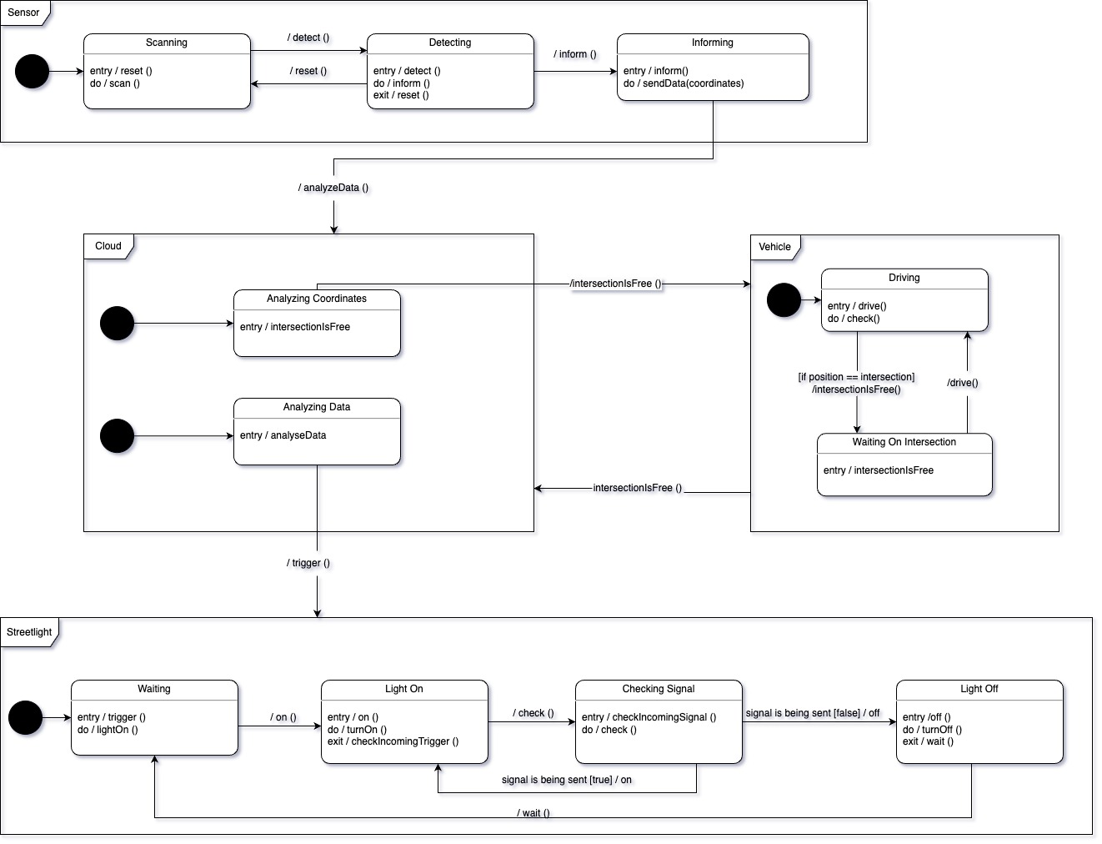
State Machine
Smart Street Lighting System
State Machine diagram representation

Slide 14
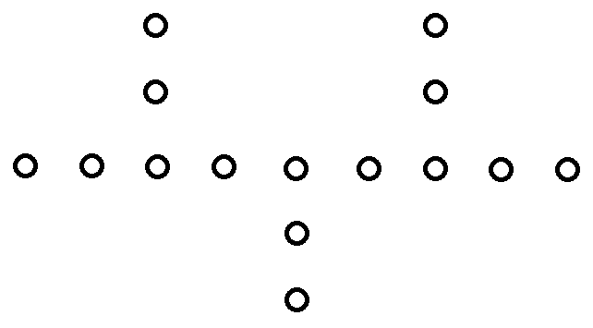
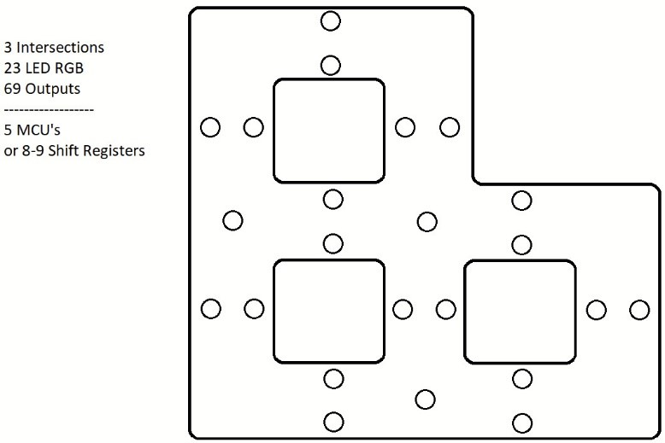
Concept solutions
Solution 1
Solution 2
Smart streetlights with 3 intersections. A vehicle can pass from left to right, with the lights becoming bright as the vehicle passes. As it passes the intersection, all surrounding lights turn on.
Smart traffic control. Two lanes, 3-4 vehicles. Only 1 vehicle can be in an intersection at once. The vehicles can drive around randomly, following a track or do figure eights etc.
Notes:
Start with talking about having 2 concept solutions after receiving feedback from
Press next to make solution 1 appear and talk about it
Press next to make solution 2 appear and talk about it
Talk about that the team chose solution 1 after receiving feedback from the professor

Slide 15
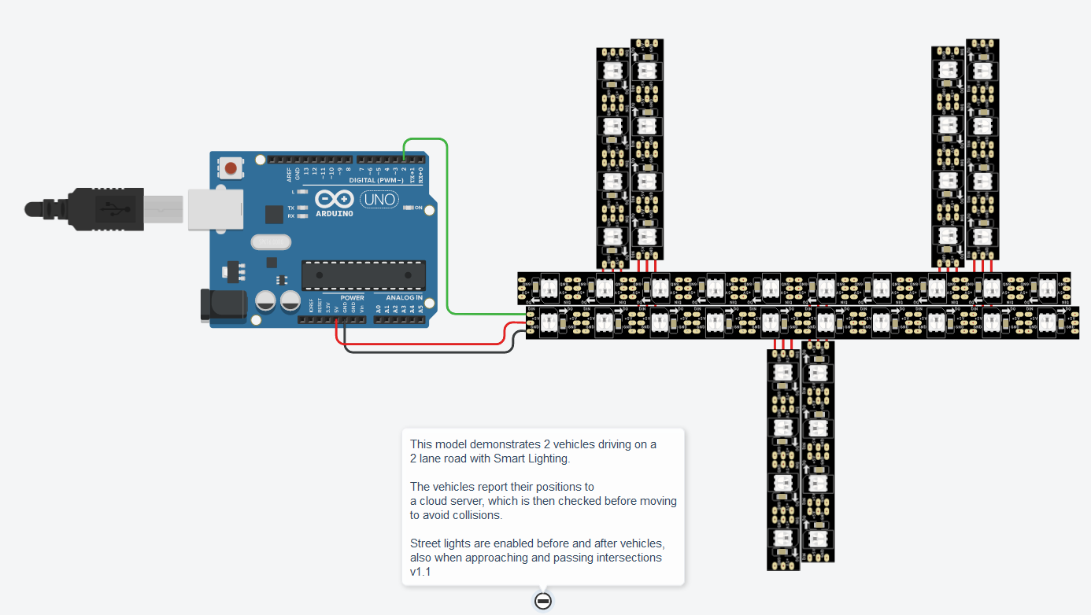
Tinkercad
Arduino Uno
Atmega328p
1 core / 1 thread
6x 4-NeoPixel strips
2x 10-NeoPixel strips
Notes:
We used Tinkercad software to simulate an Arduino Uno
Arduino uno uses an MCU called Atmega328p
This MCU only has 1 core / thread to work with
Attached to it are 6 NeoPixel RGB LED strip to simulate streetlights and vehicles

Slide 16
Tinkercad
Github
Demonstration
Notes:
We used Tinkercad software to simulate an Arduino Uno
Arduino uno uses an MCU called Atmega328p
This MCU only has 1 core / thread to work with
Attached to it are 6 NeoPixel RGB LED strip to simulate streetlights and vehicles

Slide 17
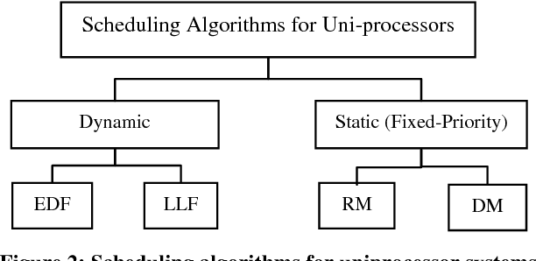
Task Scheduling
Arduino Uno
Atmega328p
1 core / 1 thread
Scheduling
Rate-Monotonic = RMS
Earliest Deadline First = EDF
Tasks
Clear Model
Add street/intersection lighting
Add vehicles
Update LED’s
Update vehicle Position’s
Notes:
First talk about the scheduling algorithms
press next to make Arduino uno text appear
Talk about the uno only having 1 core to work with
Press next to make possible schedulings and the redd cross appear
Talk about comparing these two schedules
Press next to make all tasks apear for within the code
Talk about these tasks and how we measured their timing

Slide 18
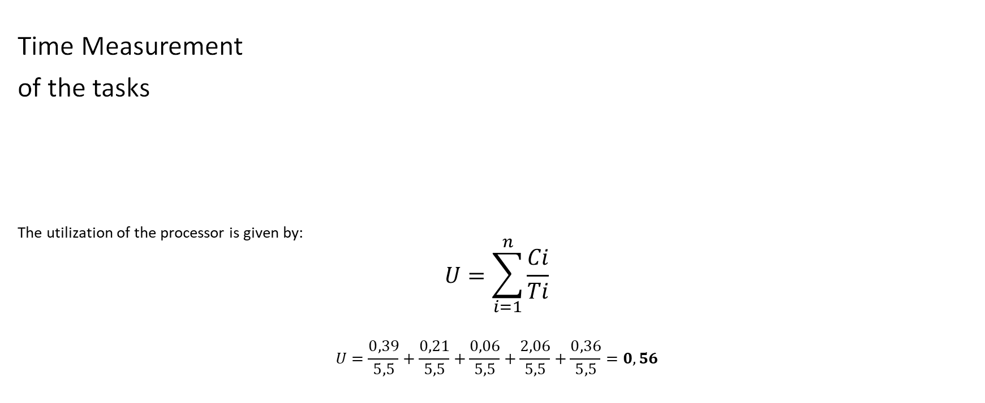
Task Scheduling
Time Measurement
of the tasks
The utilization of the processor is given by:
$$U=\sum_{i=1}^{n}{\frac{Ci}{Ti}}$$
$$U=\frac{0,39}{5,5}+\frac{0,21}{5,5}+\frac{0,06}{5,5}+\frac{2,06}{5,5}+\frac{0,36}{5,5}=0,56$$
 | Clear model | Add street/intersection lighting to model | Add vehicles to model | Update LEDs | Update vehicle positions
A_{i} | 0ms | 0.5ms | 1ms | 1.5ms | 4ms
C_{i} | 0.39ms | 0.21ms | 0.06ms | 2.06ms | 0.36ms
D_{i} | 5.5ms | 5.5ms | 5.5ms | 5.5ms | 5.5ms
T_{i} | 5.5ms | 5.5ms | 5.5ms | 5.5ms | 5.5ms
U : CPU Utilisation
Ai : Arrival Time
Ci : Execution Time
Di : Deadline Time
Ti : Period
n : nr of tasks

Slide 19

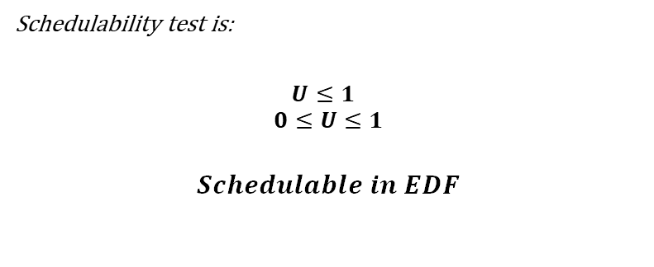

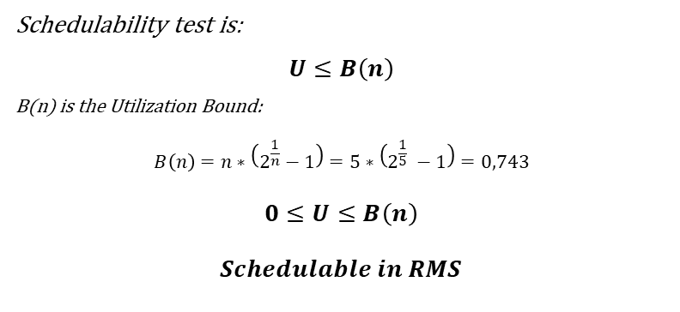
Task Scheduling
 | Clear model | Add street/intersection lighting to model | Add vehicles to model | Update LEDs | Update vehicle positions
A_{i} | 0ms | 0.5ms | 1ms | 1.5ms | 4ms
C_{i} | 0.39ms | 0.21ms | 0.06ms | 2.06ms | 0.36ms
D_{i} | 5.5ms | 5.5ms | 5.5ms | 5.5ms | 5.5ms
T_{i} | 5.5ms | 5.5ms | 5.5ms | 5.5ms | 5.5ms
$$U=\sum_{i=1}^{n}{\frac{Ci}{Ti}}=0,56$$
EDF
RMS
Schedulability test is:
$$U≤1$$
$$0≤U≤1$$
$$Schedulable in EDF$$
Schedulability test is:
$$U≤B\left(n\right)$$
B(n) is the Utilization Bound:
$$B\left(n\right)=n∗\left(2^{\frac{1}{n}}−1\right)=5∗\left(2^{\frac{1}{5}} −1\right)=0,743$$
$$0≤U≤B\left(n\right)$$
$$Schedulable in RMS$$

Slide 20
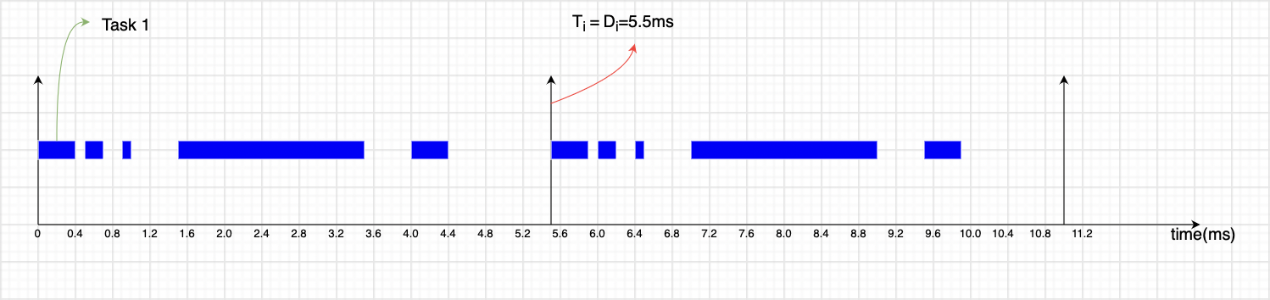
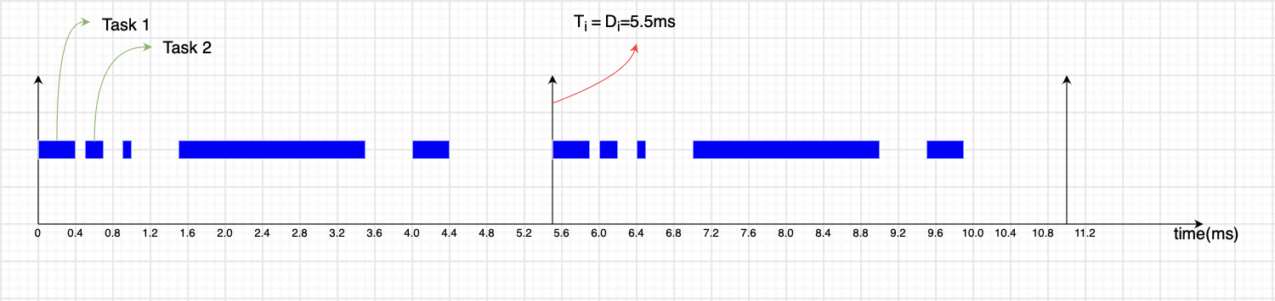
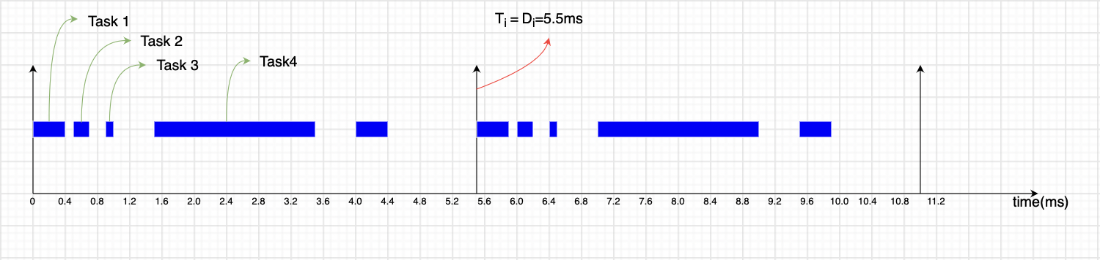
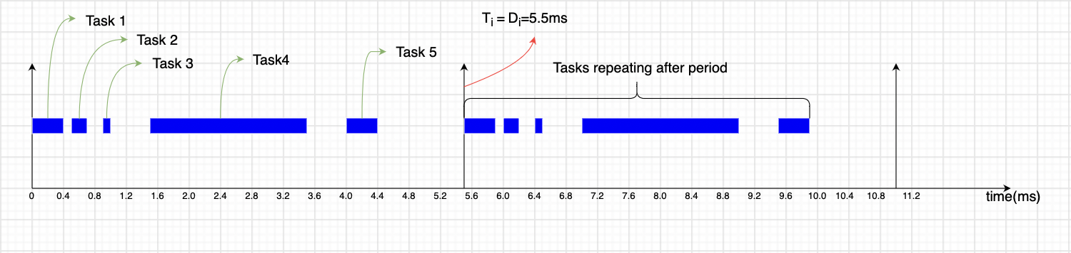
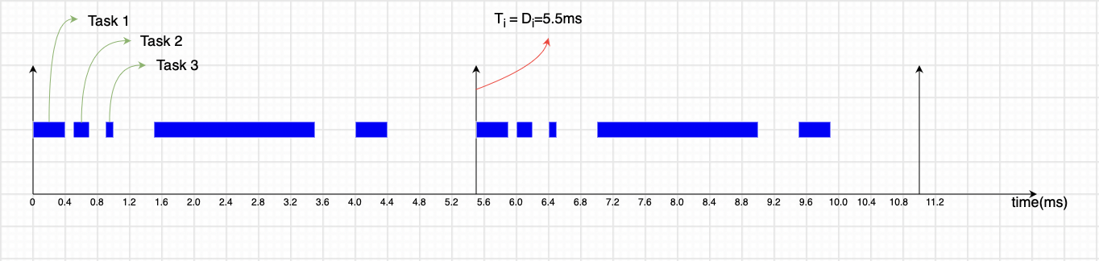
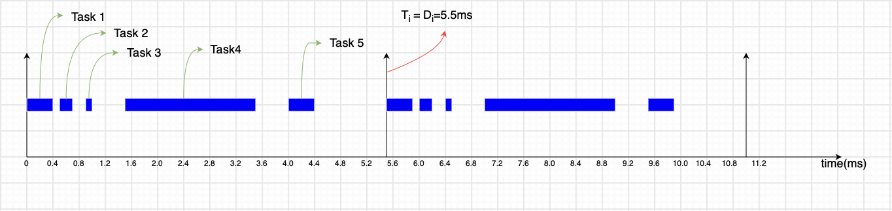
Task Scheduling
*One core processor means one task coming after the other.

Slide 21
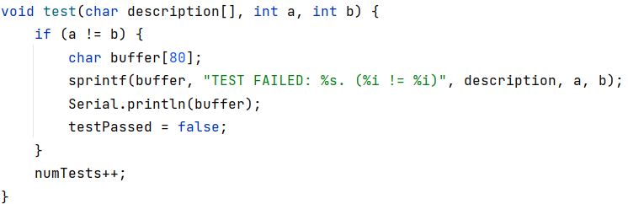
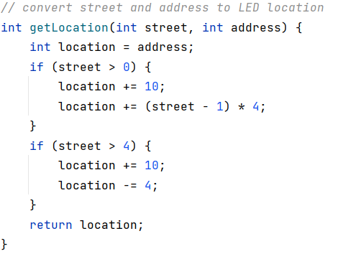
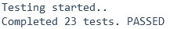
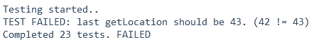
Unit Testing
23 unit tests have been written to cover all functions, classes and methods.
Example unit test:

Slide 22
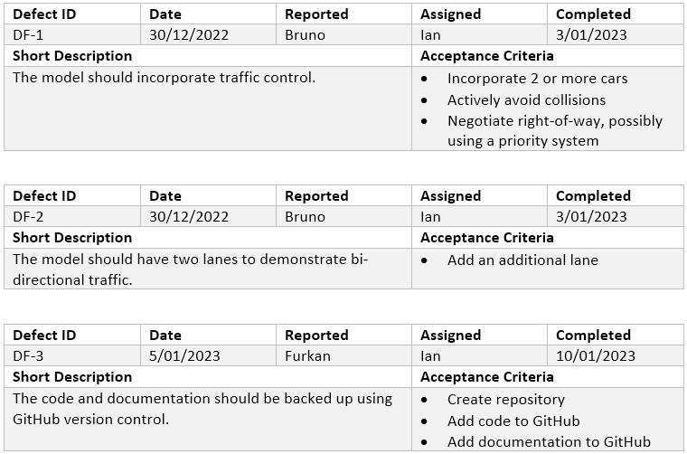
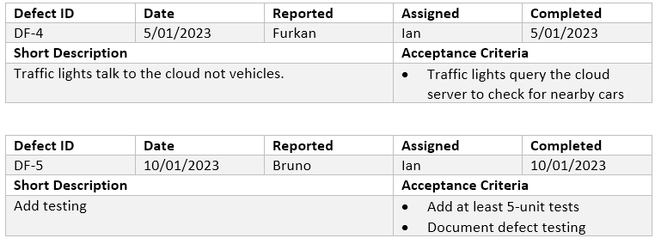
Defect Testing

Slide 23
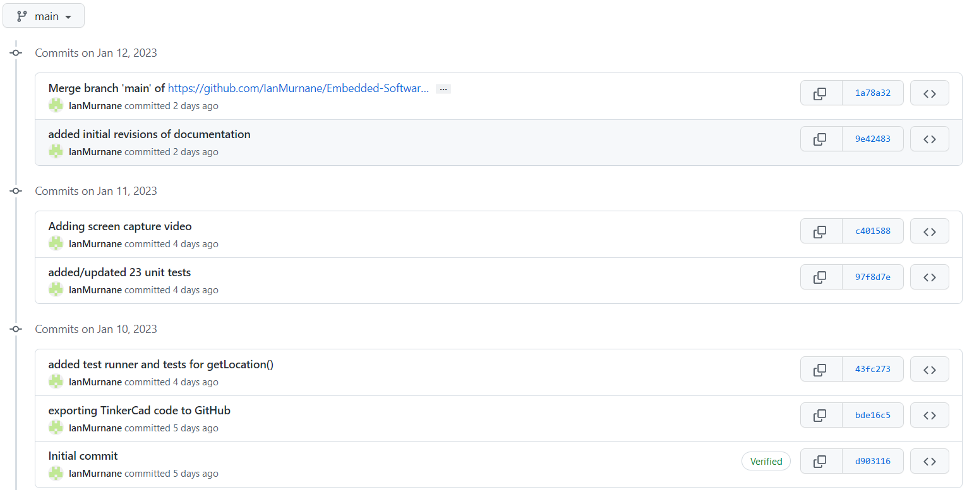
Version Control
https://github.com/IanMurnane/Embedded-Software-Engineering

Slide 24

Time for debate

